Slide 1
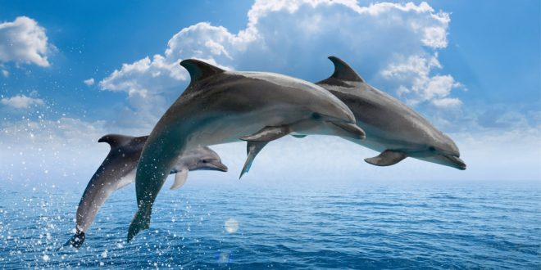
The World Of Dolphins

Slide 2
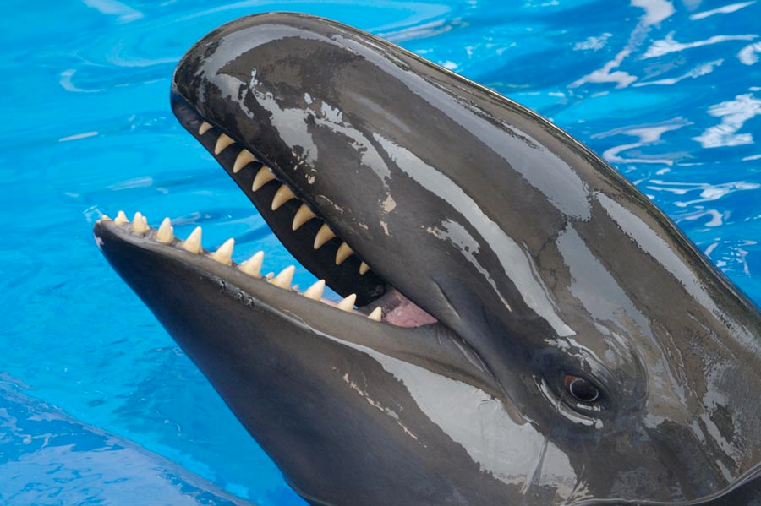
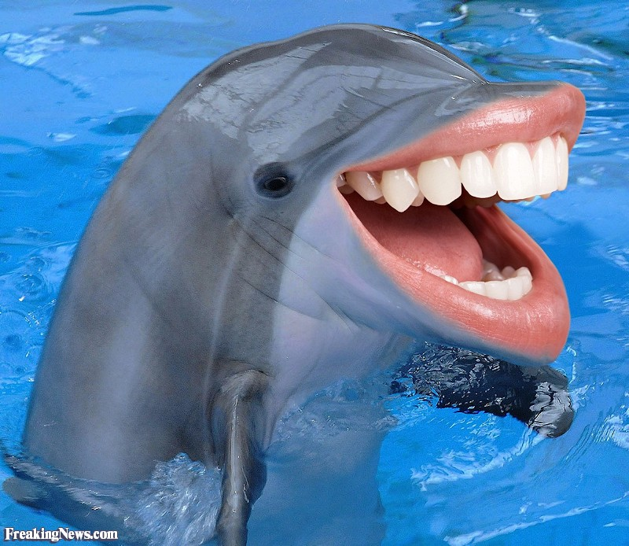

Slide 3

Which one is the most important body part for a dolphin?
The left front fin
The dorsal fin
The lower jaw
The ears
The legs
After the poll, I will tell you which one it is and why.
Conduct an interactive poll with
https://slidelizard.com

Slide 5
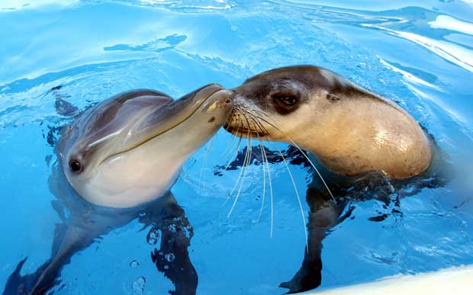

Slide 7
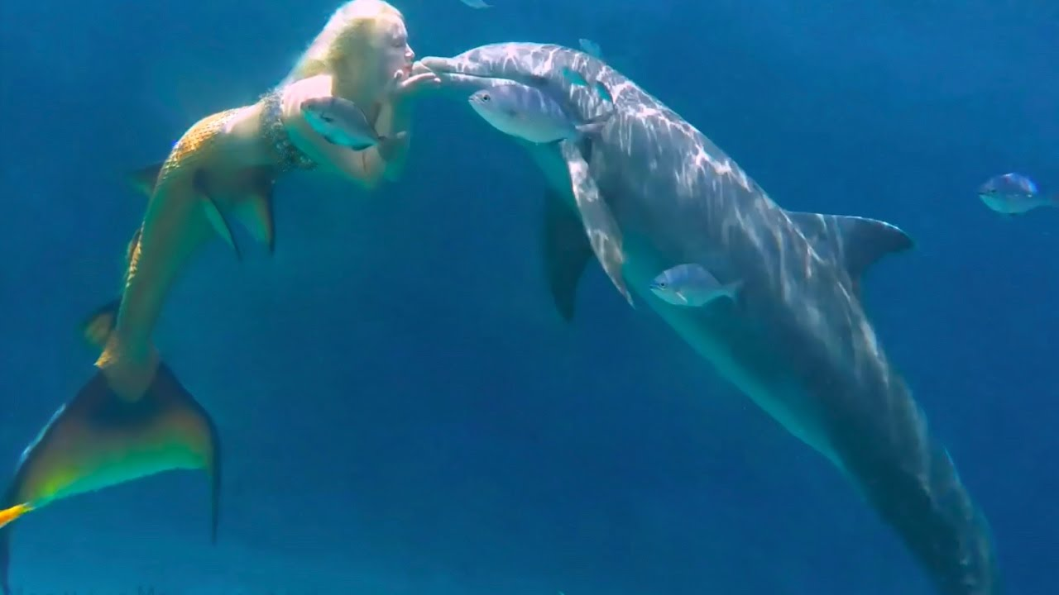

Slide 8


Slide 9


Slide 10
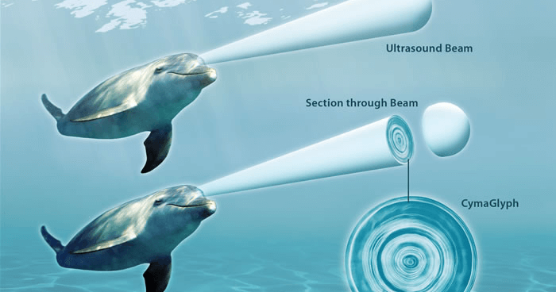

Slide 11
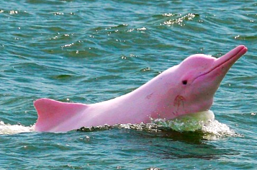

Slide 12
Which statements are true?
The pink dolphin in the previous slide was photoshopped.
Flipper’s voice was made by an Australian bird called kookaburra, not by a dolphin.
Dolphins can sleep with one eye open.
The presenter has no clue about dolphins.
Yes.
Conduct an interactive poll with
https://slidelizard.com/en

Slide 13

The End

